Slide 1
ENG 346 Data Structures and Algorithms for Artificial Intelligence Runtime Complexity of the Algorithms
Dr. Mehmet PEKMEZCİ
mpekmezci@gtu.edu.tr
https://github.com/mehmetpekmezci/GTU-ENG-346

Slide 2
Complexity
Time complexity measures the amount of time (CPU Cycles) an algorithm takes to complete as a function of the input size. It’s a way to estimate the running time of an algorithm.
Big O Notation (O-notation): This is used to describe the upper bound of an algorithm’s running time. It tells you how the runtime scales with the size of the input.
Space complexity measures the amount of memory (RAM) an algorithm uses as a function of the input size.
Big O Notation (O-notation): Just like time complexity, space complexity can be expressed in Big O notation.

Slide 3
Definitions: Big Ο
Worst Case Scenario
Upper-bound of a function f(n)
Let f(n) and g(n) be functions mapping positive integers to positive real numbers. We say that f(n) is O(g(n)) if
there is a real constant c > 0 and
an integer constant n0 ≥ 1 such that
f(n) ≤ c g(n), for n ≥ n0.
f(n) is O(g(n))

Slide 4
Big Ο Rules
Simplifications:
If is f(n) a polynomial of degree d, then f(n) is O(n^d), i.e.,
Drop lower-order terms
Drop constant factors
Use the smallest possible class of functions
Say “2n is O(n)” instead of “2n is O(n^2)”
Use the simplest expression of the class
Say “3n + 5 is O(n)” instead of “3n + 5 is O(3n)”

Slide 5

Time Complexity Calculation n²
O(N²) = (100)² ⁼ 10000

Slide 6
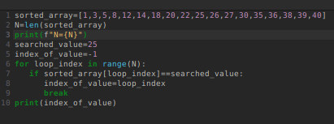
Time Complexity Calculation n
O(N) = (100) ⁼ 100

Slide 7
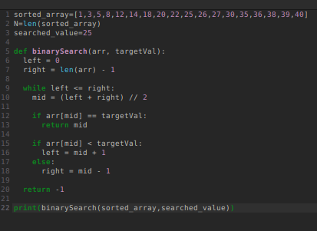
Time Complexity Calculation log(n)
Binary Search Algorithm
O(log2(N)) = log2(100)
MASTER THEOREM :
(Complexity for Recursive Algos.)
T(N) = aT(N/b) + f(N)
a = recursive call
b = divided sub problems
f(N)= complexity of one loop/call step
T(N) = T(N/2) + O(1)
→ Apply the rule in theorem.

Slide 8
Basics
Name | Function | Relation | Example
Constant Time | f(n) = c | Does not depend on input size. | Accessing array elements.
Logarithmic Time | f(n) = log n | Running time increases logarithmically with the input size. | Binary search.
Linear Time | f(n) = n | Running time increases linearly with the input size. | Iterating through an array or list.
Linearithmic Time | f(n) = n log n | The running time grows slower than O(n^2) but faster than O(n). | Efficient sorting algorithms like quicksort and mergesort.
Quadratic Time | f(n) = n^2 | Running time grows proportionally to the square of the input size. | Algorithms with nested loops, such as selection sor tor bubble sort.
Polynomial Time | f(n) = n^k | Running time is a polynomial function of the input size. | Algorithms with “k” nested loops.
Exponential Time | f(n) = 2^n | Running times that grow very rapidly with the input size. | N-P complete problems, such as traveling salesman.

Slide 9
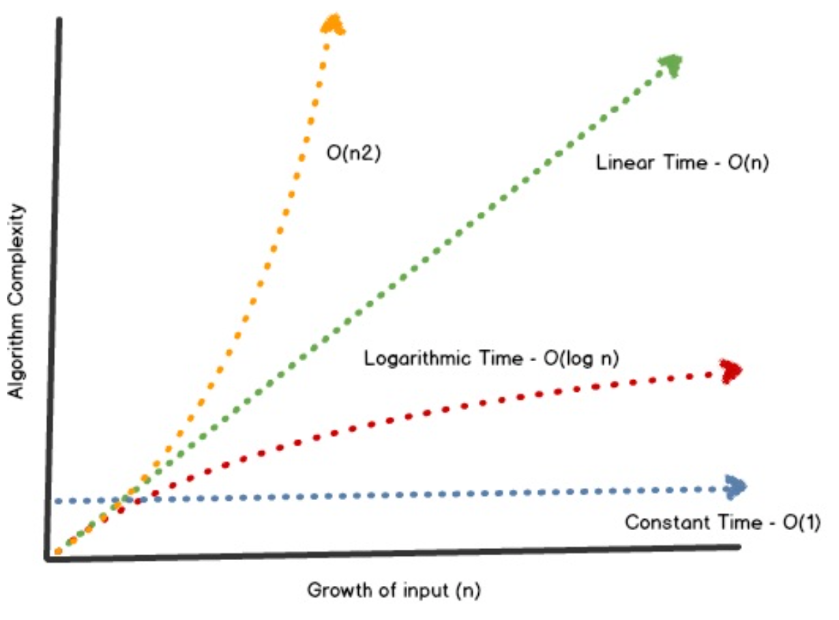
Growth Rates

Slide 10
Examples:
7n-2 is O(n)
3n³ + 20n² + 5 is O(n³)
3 log n + 5 is O(log n)

Slide 11
Time-Space Complexity Trade-off
Time Complexity : Recalculate the values in each step of computation.
Space Complexity: Cache the calculated values and use pre-calculated values if possible.
Compressed or Uncompressed data
Re Rendering or Stored images
Smaller code or loop unrolling
Lookup tables or Recalculation

Slide 12
Access Times
CPU Speed = 1 cycle ( 1 cycle = 0.3 ns for a 3GHz CPU)
CPU Register = 1 cycle
L1 Cache = 3 cycles
L2 Cache = 10 cycles
L3 Cache = 40 cycles
RAM = 100 cycles
SSD = 10K cycles
HDD = 10M cycles

Slide 13
Exercises
Book: R-3.1

